Slide 1
Robust Object Detection in Different Environmental Conditions
Doctoral Dissertation
Student : Le Trung Hieu
Advisor: Prof. Shih-Chia Huang
Date: May 12th, 2020

Slide 2
Contents
I
Introduction
II
Previous works
III
Proposed Method
IV
Experimental Results

Slide 3
Contents
I
Introduction
II
Previous works
III
Proposed Method
IV
Experimental Results

Slide 4
I. Introduction
Object detection is the process of finding real-world object instances in still images or videos
It plays an important role in the area of computer vision applications: intelligent autonomous vehicles, smart health care, and video surveillance.
Object detectors: RetinaNet [1], YOLO-v3 [2], SSD [3], Faster- RCNN [4], etc.

Slide 5
I. Introduction
The Problems:
These object detectors work well in normal weather and big objects
Can not detect accurately in adverse conditions: inclement weather, and small object.
Notes:
remains a major challenge because of poor visibility

Slide 6
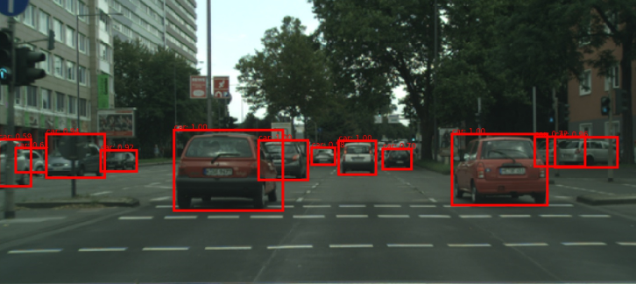
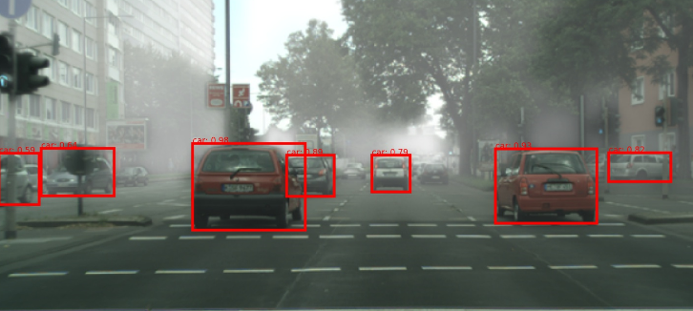
I. Introduction
Reasons:
In inclement weather conditions such as haze/fog, the visibility of objects was degraded.
a) Normal weather
b) Foggy weather
Detection example with RetinaNet [1]
Notes:
remains a major challenge because of poor visibility

Slide 7
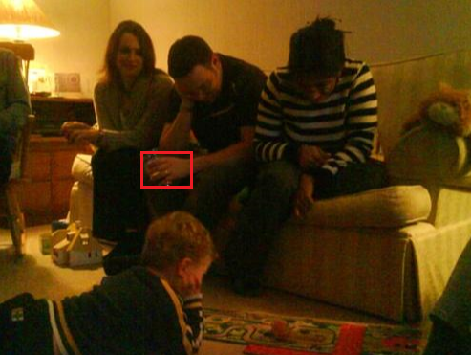
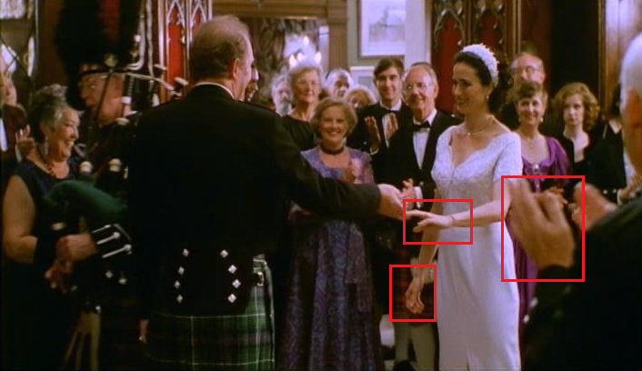
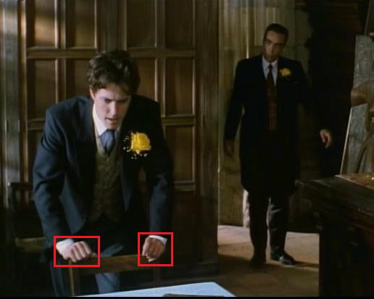
I. Introduction
Reasons:
Small objects: the limited number of pixels and numerous possibilities of the locations in images.
Human hands are generally small objects, vary in shape and viewpoint in images.
The challenge is more serious when detecting in indoor environment because of cluttered backgrounds and low light sources.
Hand detection example with SSD [3]
Notes:
Numerous /ˈnuː.mə.rəs/
Challenge /ˈtʃæl.ɪndʒ/

Slide 8
Contents
I
Introduction
II
Previous works
III
Proposed Method
IV
Experimental Results

Slide 9
II. Previous Work
2.1. Object detection in inclement weather conditions
Image restoration model
Restored Images
Object
detector
Loc
Degraded Images
Cls
Combination model between image restoration model and object detector
Step1: Enhancing the visibility of degraded images
Step2: Using restored images as the input of object detector
Notes:
Restoration /ˌres.təˈreɪ.ʃən/

Slide 10
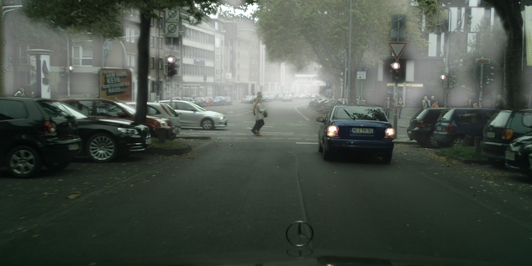
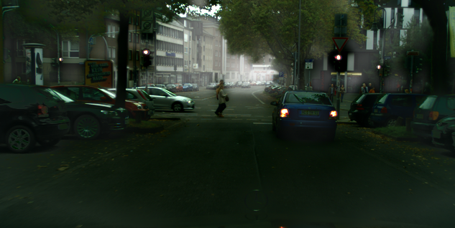
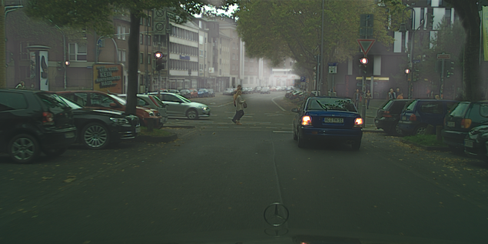
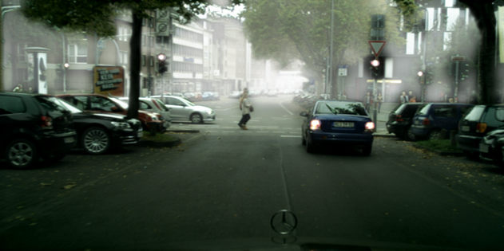
II. Previous Work
Hazy images
CAP [5] (IEEE Transactions’15)
AOD-NET [6] (ICCV’17)
DCPDN [7] (CVPR’18)
Notes:
CAP: Color Attenuation Prior
AOD-Net: All-in-one dehazing network
DCPDN: Densely connected pyramid dehazing network

Slide 11
II. Previous Work
2.1. Object detection in inclement weather conditions
Image restoration model
Restored Images
Object
detector
Loc
Degraded Images
Cls
Limitation :
Using better models in terms of restoration performance:
Does not always guarantee improved detection performance [8]
Deteriorate detection performance [9]
Reduce the speed of detection
Notes:
/dɪˈtɪr.i.ə.reɪt/

Slide 12
II. Previous Work
2.2. Human hand detection
Mittal et al. [10] proposed three hand detectors:
Hand shape detector,
Context detector,
Skin-based detector.
Average precision (AP): 48.20 %
Speed: 55 second per image (0.018 FPS)

Slide 13
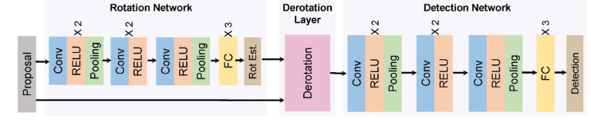
II. Previous Work
2.2. Human hand detection
Xiaoming et al. [11] proposed a CNN to join hand detection and rotation estimation.
Average precision (AP): 58.01 %
Speed: 0.1 second per image (10 FPS)

Slide 14
Contents
I
Introduction
II
Previous works
III
Proposed Method
IV
Experimental Results

Slide 15
III. Proposed Method
Object Detection
Dual-subnet network
(DSNet)
For object detection in inclement weather condition
Cross-Resolution Feature
Fusion (CFF)
For fast hand detection in indoor environment condition

Slide 16
III. Proposed Method
Object Detection
Dual-subnet network
(DSNet)
For object detection in inclement weather condition
Cross-Resolution Feature
Fusion (CFF)
For Fast Hand Detection in the indoor environment condition

Slide 17
III-1. Proposed DSNet Method
1. DSNet architecture
Previous method
Image restoration model
Restored Images
Object
detector
Loc
Degraded Images
Cls
Our method
Image restoration model
Degraded Images
Object detector
Loc
Cls

Slide 18
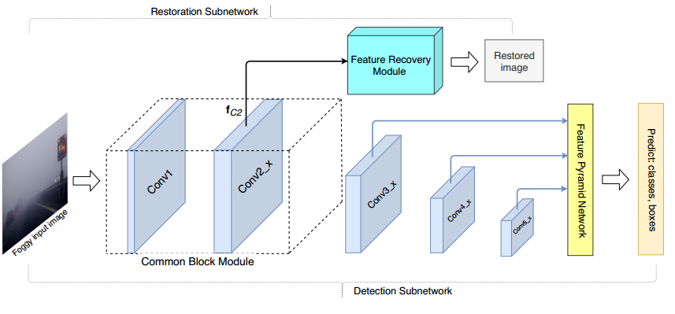
III-1. Proposed DSNet Method
1. DSNet architecture
The architecture of DSNet
Detection subnet: Employing RetinaNet [1] for object classification and localization.
Restoration subnet: Attaching a proposed feature recovery (FR) module to the CB module for visibility enhancement
Notes:
RetinaNet is employed as the base architecture
Module /ˈmɑː.dʒuːl/

Slide 19
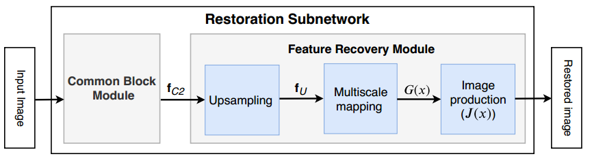
III-1. Proposed DSNet Method
1. DSNet architecture
Flowchart of restoration subnetwork
a) Common Block (CB) module:
Is shared by the detection subnet
Consist of first 10 convolutional layers
Extracting the feature of the input image
Notes:
RetinaNet is employed as the base architecture

Slide 20
III-1. Proposed DSNet Method
1. DSNet architecture
b) Feature Recovery (FR) module:
Upsampling submodule: using bilinear interpolation technique match the resolutions of f_{C2} and the input image
Multiscale mapping (MM) submodule: employing 4 parallel convolutions (1 × 1, 3 × 3, 5 × 5, and 7 × 7) for multiscale feature extraction.
Image production (IP) module: for producing the restored image.
Notes:
RetinaNet is employed as the base architecture

Slide 21
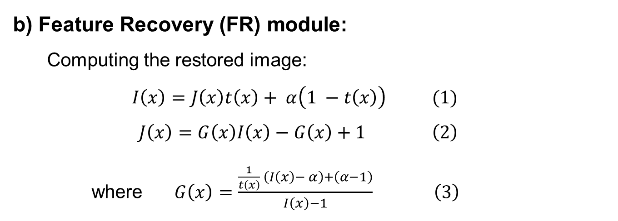
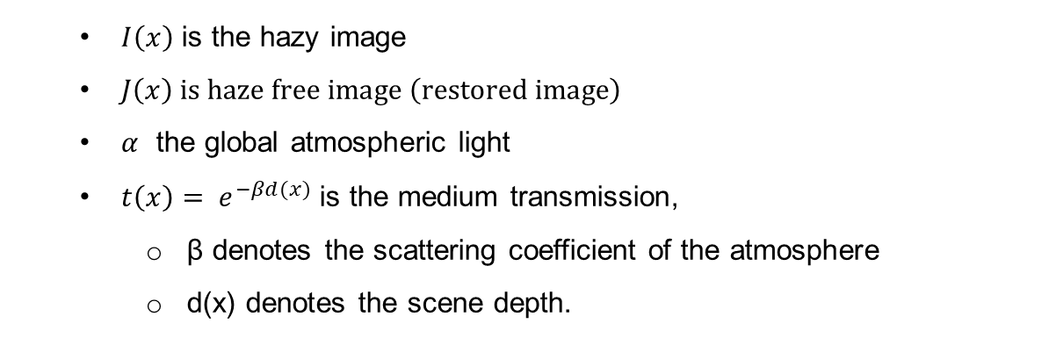
III-1. Proposed DSNet Method
1. DSNet architecture
b) Feature Recovery (FR) module:
Computing the restored image:
$$I\left(x\right)=J\left(x\right)t\left(x\right)+ α\left(1 −t\left(x\right)\right) (1)$$
$$J\left(x\right)=G\left(x\right)I\left(x\right)−G\left(x\right)+1 \left(2\right)$$
where $G\left(x\right)=\frac{\frac{1}{t\left(x\right)} \left(I\left(x\right)− α\right)+\left(α−1\right)}{I\left(x\right)−1} \left(3\right)$
$I\left(x\right)$ is the hazy image
$J\left(x\right) is haze free image \left(restored image\right)$
$α$ the global atmospheric light
$t\left(x\right)= e^{−βd(x)}$ is the medium transmission,
β denotes the scattering coefficient of the atmosphere
d(x) denotes the scene depth.
Notes:
RetinaNet is employed as the base architecture

Slide 22
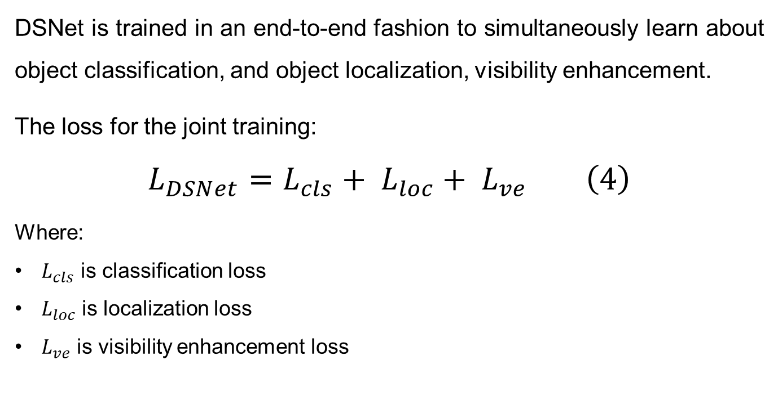
III-1. Proposed DSNet Method
2. Training DSNet
DSNet is trained in an end-to-end fashion to simultaneously learn about object classification, and object localization, visibility enhancement.
The loss for the joint training:
$$L_{DSNet}=L_{cls}+ L_{loc}+ L_{ve} \left(4\right)$$
Where:
$L_{cls}$ is classification loss
$L_{loc}$ is localization loss
$L_{ve}$ is visibility enhancement loss
Notes:
RetinaNet is employed as the base architecture

Slide 23
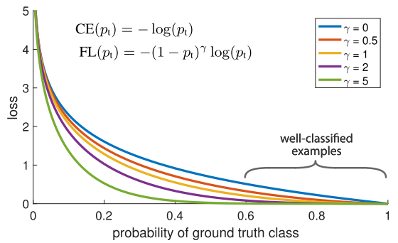
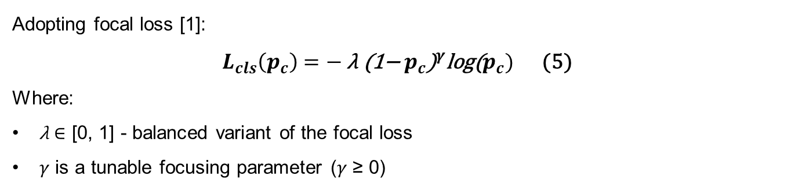
III-1. Proposed DSNet Method
2. Training DSNet
Classification loss
Adopting focal loss [1]:
$L_{cls}\left(p_{c}\right)=− \text{λ} {\text{(1−}{ p}_{c}\text{)}}^{γ}\text{log}\text{(}p_{c})$ (5)
Where:
$\text{λ}$ $∈$ [0, 1] - balanced variant of the focal loss
$γ$ is a tunable focusing parameter ($γ$ ≥ 0)
Notes:
$\text{gamma} γ$ = 2 work best
Focal loss add very less weight to well classified examples and large weight to miss-classified or hard classified examples.
down-weight the contribution of easy examples during training

Slide 24
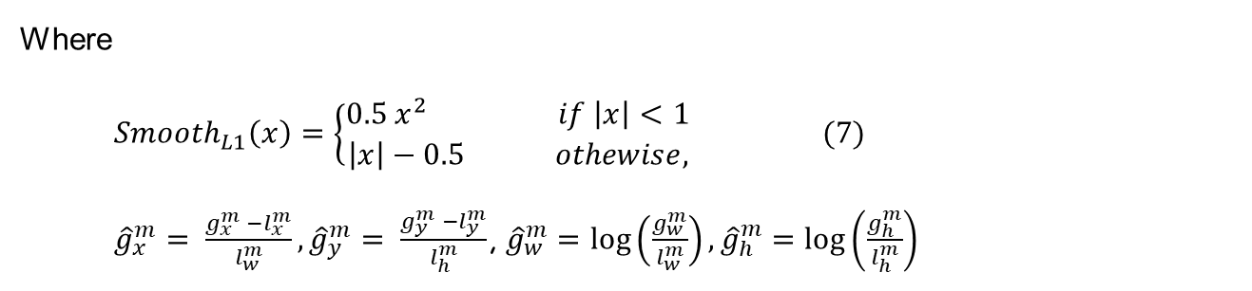
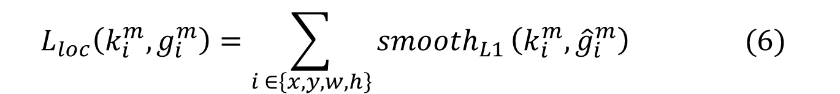
III-1. Proposed DSNet Method
2. Training DSNet
Localization loss:
Adopting Smooth_{L1} loss [11] between the predicted box (k) and the ground truth box (g) parameters.
$$L_{loc}\left(k_{i}^{m},g_{i}^{m}\right)=\sum_{i ∈\left\{x, y, w, h\right\}}{{smooth}_{L1}}\left(k_{i}^{m},{\hat{g}}_{i}^{m}\right) (6)$$
Where
${Smooth}_{L1}\left(x\right)=\left\{\begin{aligned}0.5 x^{2 } if \left|x\right|<1 \\ \left|x\right|−0.5 othewise,\end{aligned} (7)\right.$
${\hat{g}}_{x}^{m}= \frac{g_{x}^{m} −l_{x}^{m}}{l_{w}^{m}},{\hat{g}}_{y}^{m}= \frac{g_{y}^{m} −l_{y}^{m}}{l_{h}^{m}}$, ${\hat{g}}_{w}^{m}=\log\left(\frac{g_{w}^{m}}{l_{w}^{m}}\right),{\hat{g}}_{h}^{m}=\log\left(\frac{g_{h}^{m}}{l_{h}^{m}}\right)$
Notes:
For each anchor box with a match, a ground truth box regression is defined as ${\hat{g}}^{m}=\left({\hat{g}}_{x}^{m},{\hat{g}}_{y}^{m},{\hat{g}}_{w}^{m},{\hat{g}}_{h}^{m}\right),$ and a corresponding predicted box $k^{m}=\left(k_{x}^{m},k_{y}^{m},k_{w}^{m},k_{h}^{m}\right)$. Here,
$x, y, w, and h$ are the two center coordinates of the box, width, and height, respectively

Slide 25
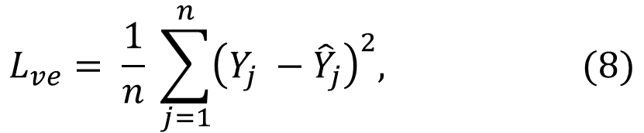
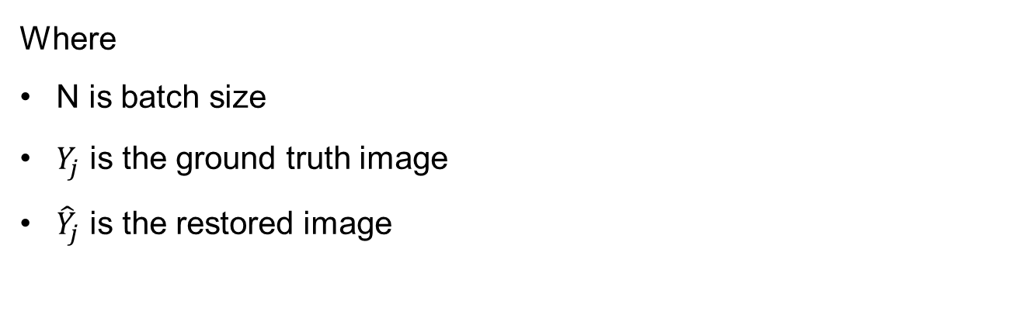
III-1. Proposed DSNet Method
2. Training DSNet
Visibility enhancement loss:
Adopting mean square error (MSE) loss
$$L_{ve}= \frac{1}{n} \sum_{j=1}^{n}{{\left(Y_{j} −{\hat{Y}}_{j}\right)}^{2}, (8)}$$
Where
N is batch size
$Y_{j}$ is the ground truth image
${\hat{Y}}_{j}$ is the restored image
Notes:
RetinaNet is employed as the base architecture

Slide 26
III. Proposed Method
Object Detection
Dual-subnet network
(DSNet)
For object detection in inclement weather condition
Cross-Resolution Feature
Fusion (CFF)
For fast hand detection in indoor environment condition

Slide 27
III. Proposed Method
Object Detection
Dual-subnet network
(DSNet)
For object detection in inclement weather condition
Cross-Resolution Feature
Fusion (CFF)
For fast hand detection in indoor environment condition

Slide 28
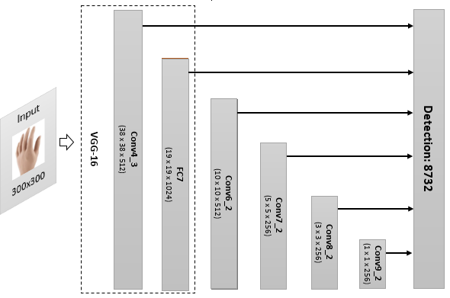
III-2. Proposed CFF Method
1. Base Detector
The architecture of Single Shot MultiBox Detector (SSD-300)
Notes:
RetinaNet is employed as the base architecture

Slide 29
III-2. Proposed CFF Method
1. Base Detector
The problems:
The features of small objects generated by shallow layers lack sufficient semantic information.
→ low performance in the detection of small objects
Solution:
Add useful context information and semantic information to the shallower layers.
Notes:
RetinaNet is employed as the base architecture

Slide 30
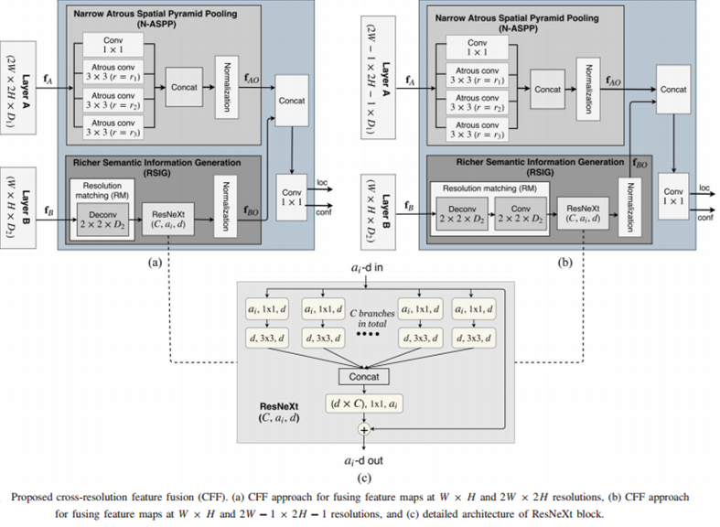
III-2. Proposed CFF Method
1. CFF architecture
Proposed cross-resolution feature fusion (CFF). (a) CFF approach for fusing feature maps at W × H and 2W × 2H resolutions, (b) CFF approach for fusing feature maps at W × H and 2W − 1 × 2H − 1 resolutions, and (c) detailed architecture of ResNeXt block.
Notes:
RetinaNet is employed as the base architecture

Slide 31
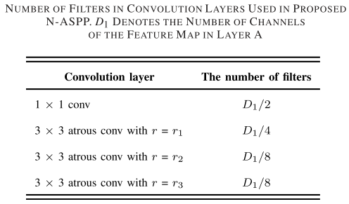
III-2. Proposed CFF Method
1. CFF architecture
Narrow Atrous Spatial Pyramid Pooling (N-SPP) Module
Four parallel convolutions: One 1 × 1 convolution and three 3x3 atrous convolutions with different small rates
Notes:
RetinaNet is employed as the base architecture

Slide 32
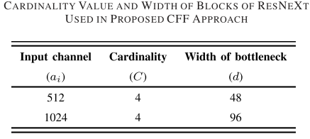
III-2. Proposed CFF Method
1. CFF architecture
b) Richer Semantic Information Generation (RSIG) Module
Resolution matching: Matching the resolutions of features at different layers by using Deconvolution layer
ResNeXt: Exploiting richer semantic information
Notes:
RetinaNet is employed as the base architecture

Slide 33
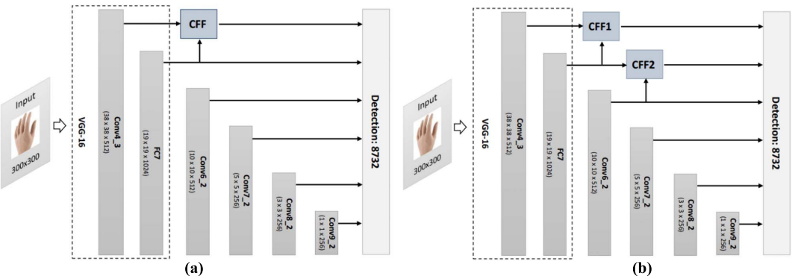
III-2. Proposed CFF Method
2. Training CFF-SSD model
Proposed hand detection architectures. (a) 1CFF-SSD: one CFF connects the features from the Conv4_3 and FC7 layers. (b) 2CFF-SSD: two CFFs connect the features from Conv4_3, FC7, and Conv6_2 layers.
Notes:
RetinaNet is employed as the base architecture

Slide 34
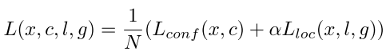
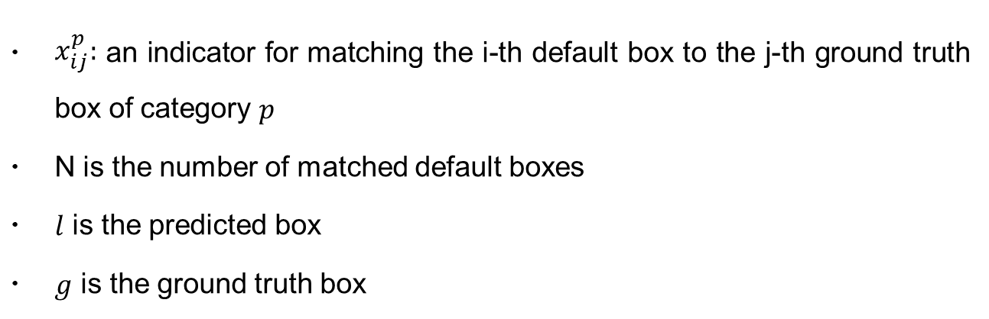
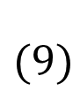
III-2. Proposed CFF Method
2. Training CFF-SSD model
The overall objective loss function is described as
$$(9)$$
$x_{ij}^{p}:$ an indicator for matching the i-th default box to the j-th ground truth box of category $p$
N is the number of matched default boxes
$l$ is the predicted box
$g$ is the ground truth box
Notes:
RetinaNet is employed as the base architecture

Slide 35
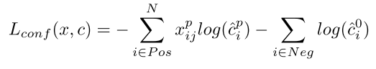
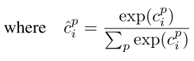
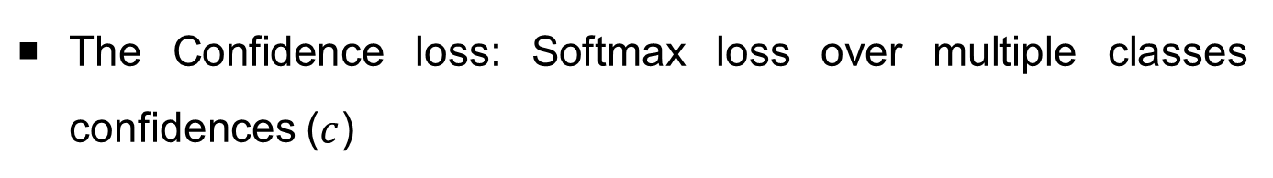
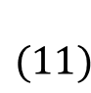
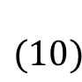
III-2. Proposed CFF Method
2. Training CFF-SSD model
The Confidence loss: Softmax loss over multiple classes confidences ($c$)
$$(10)$$
$$(11)$$
Notes:
RetinaNet is employed as the base architecture

Slide 36
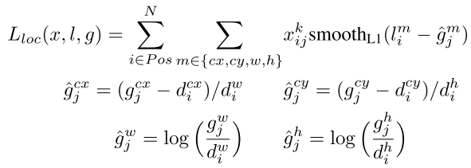
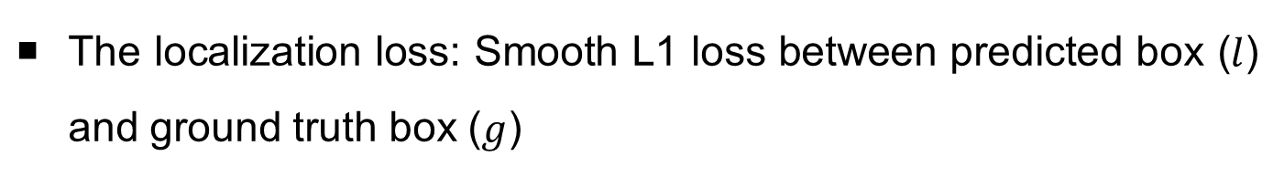
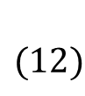
III-2. Proposed CFF Method
2. Training CFF-SSD model
The localization loss: Smooth L1 loss between predicted box ($l$) and ground truth box ($g$)
$$(12)$$
Where $d$ is default box with center ($cx, cy$), width ($w$) and height ($h$)
Notes:
RetinaNet is employed as the base architecture

Slide 37
Contents
I
Introduction
II
Previous works
III
Proposed Method
IV
Experimental Results

Slide 38
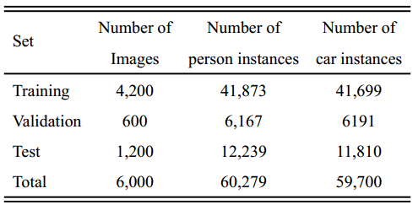
IV. Experimental Results
4.1. Object detection in foggy weather conditions
Synthetic fog Dataset (FOD dataset):
2000 images are collected from cityscapes dataset [12]
Create three synthesis fog sets using [13] : Light fog, medium fog and heavy fog
Foggy-driving dataset [13]
A natural foggy dataset that is used for testing object detection
Classes: Car (456 instances), person (297 instances)

Slide 39
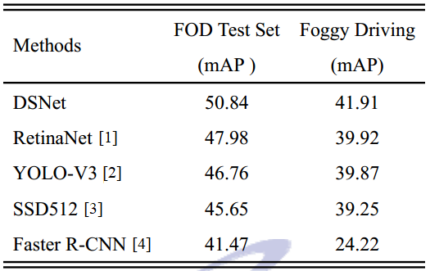
IV. Experimental Results
4.1. Object detection in foggy weather conditions
Performance Comparison of DSNet and Current Object Detectors

Slide 40
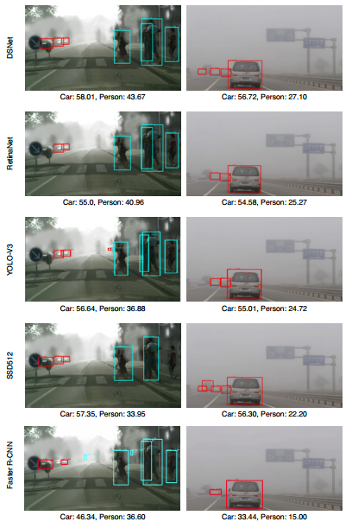
IV. Experimental Results
Detection results of our DSNet and different object detectors on synthetic foggy images (left column),
natural foggy image (right column).

Slide 41
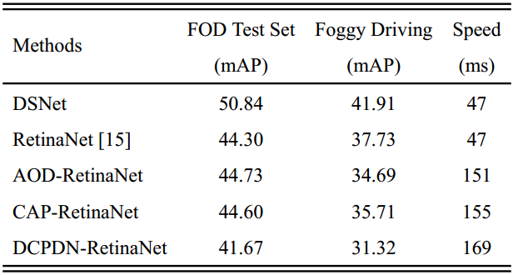
IV. Experimental Results
4.1. Object detection in foggy weather conditions
Performance Comparison of DSNet and Combination Models
Our model was trained on FOD training set
For training combination models:
Dehazing methods (CAP [5], AOD-Net [6], DCPDN [7]) were trained on FOD training set
Generate fog-free images on FOD test set and Foggy driving test set [13]
Train RetinaNet on clear images (training set)
Test RetinaNet model on fog-free images

Slide 42
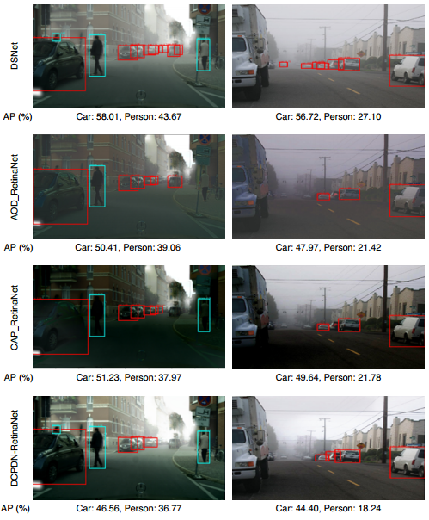
IV. Experimental Results
Detection results of our DSNet and different combination models on synthetic foggy images (left column),
natural foggy image (right column)

Slide 43
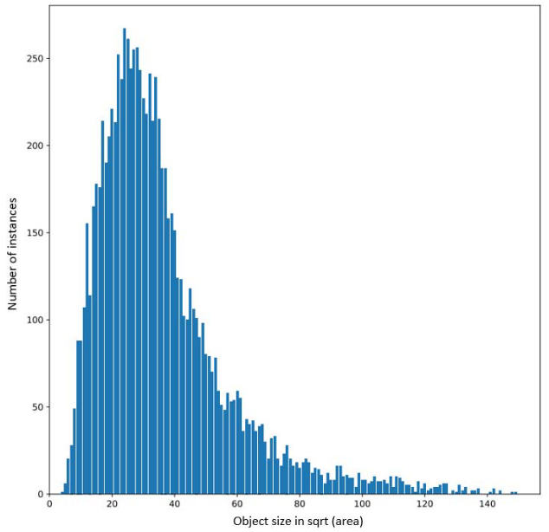
IV. Experimental Results
4.2. Human Hand Detection
Oxford Hand Dataset [10]
13,050 annotated hand instances: training set (9,163), test set (2,031), and validation set (1,856).
Size Distribution of Hands in Oxford Hand Training Set
Notes:
Contains more types of backgrounds and hand shapes compared to VIVA [5], Signer [6], and Egohands [7]

Slide 44
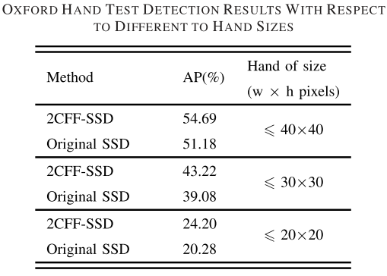
IV. Experimental Results
4.2. Human Hand Detection
Performance Comparison of DSNet and Base Detectors (SSD [3])
Notes:
Contains more types of backgrounds and hand shapes compared to VIVA [5], Signer [6], and Egohands [7]

Slide 45
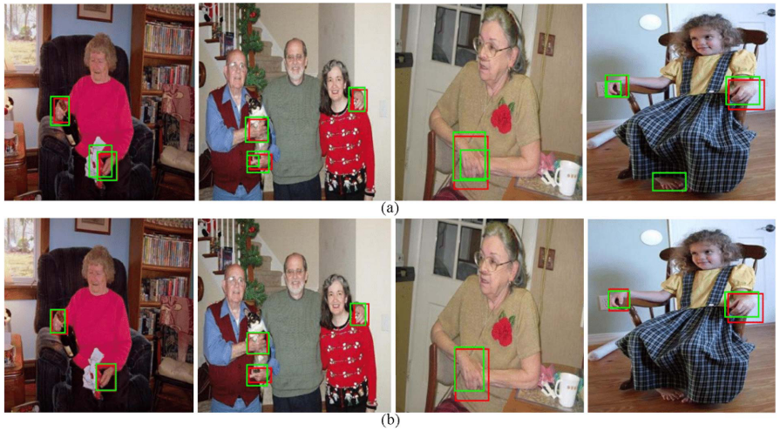
IV. Experimental Results
4.2. Human Hand Detection
Performance Comparison of DSNet and Base Detectors (SSD [3])
(a) Examples of hand detection results predicted by original SSD, and (b) those predicted by the proposed model. The red and green boxes demonstrate the ground truths and predicted bounding boxes, respectively
Notes:
Contains more types of backgrounds and hand shapes compared to VIVA [5], Signer [6], and Egohands [7]

Slide 46
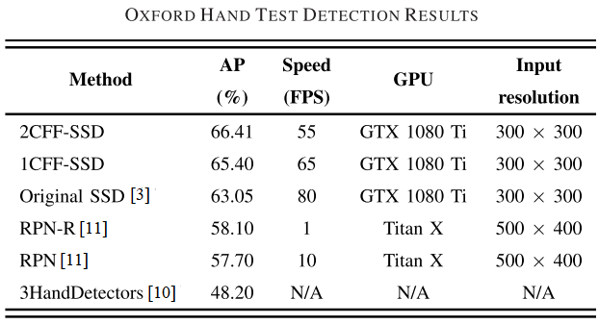
IV. Experimental Results
4.2. Human Hand Detection
Performance Comparison of DSNet and Current Hand Detectors
Notes:
Contains more types of backgrounds and hand shapes compared to VIVA [5], Signer [6], and Egohands [7]

Slide 47
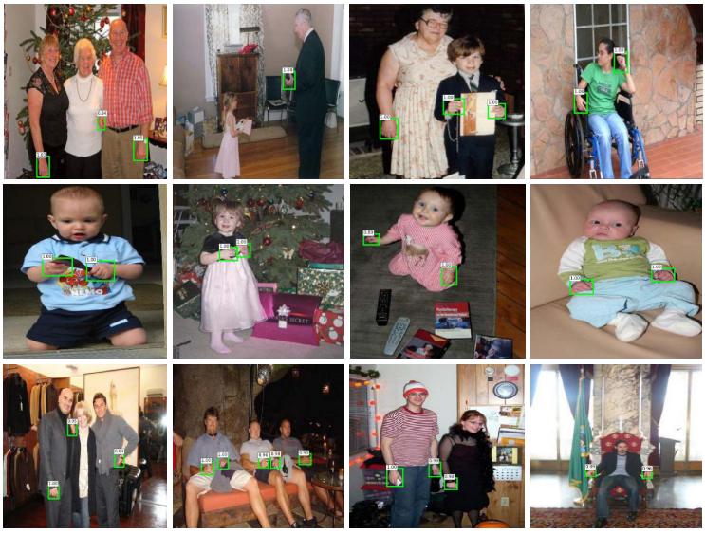
IV. Experimental Results
4.2. Human Hand Detection
A few high-scoring detection results on Oxford hand test set obtained using proposed 2CFF-SSD model.
Notes:
Contains more types of backgrounds and hand shapes compared to VIVA [5], Signer [6], and Egohands [7]

Slide 48
Publications
International Journal
[1]. Shih-Chia Huang, Trung-Hieu Le, and Da-Wei Jaw, ”DSNet: Joint Semantic Learning for Object Detection in Inclement Weather Conditions,” in IEEE Transactions on Pattern Analysis and Machine Intelligence, 2020. [Online]. Available: https://ieeexplore.ieee.org/document/9022905. [Impact factor: 17.730, rank: 1/266].
[2]. Trung-Hieu Le, Shih-Chia Huang, and Da-Wei Jaw. ”Cross-Resolution Feature Fusion for Fast Hand Detection in Intelligent Homecare Systems.” IEEE Sensors Journal, vol.19, Issue.12, pp. 4696 – 4704, 2019. [Impact factor: 3.076, rank: 87/266].
International Conference
[1]. Trung-Hieu Le, Da-Wei Jaw, I. Lin, H. Liu and S. Huang, "An efficient hand detection method based on convolutional neural network," 2018 7th International Symposium on Next Generation Electronics (ISNE), Taipei, 2018, pp. 1-2, doi: 10.1109/ISNE.2018.8394651.
[2]. Trung-Hieu Le, Viet-Quoc Hoang, Shih-Chia Huang, “An Improvement of RetinaNet for Hand Detection in Intelligent Homecare Systems”, 2020 IEEE International Conference on Consumer Electronics-Taiwan (ICCE-TW), Taoyuan, 2020 (Accepted).
[3]. Viet-Quoc Hoang, Trung-Hieu Le, Shih-Chia Huang, “Data Augmentation for Improving SSD Performance in Rainy Weather Conditions”, 2020 IEEE International Conference on Consumer Electronics-Taiwan (ICCE-TW), Taoyuan, 2020 (Accepted).
Notes:
Contains more types of backgrounds and hand shapes compared to VIVA [5], Signer [6], and Egohands [7]

Slide 49
References
[1]. Lin, T. Y., Goyal, P., Girshick, R., He, K., & Dollár, P. (2017). Focal loss for dense object detection. In Proceedings of the IEEE international conference on computer vision (pp. 2980-2988).
[2]. Redmon, J., & Farhadi, A. (2018). Yolov3: An incremental improvement. arXiv preprint arXiv:1804.02767.
[3]. Liu, W., Anguelov, D., Erhan, D., Szegedy, C., Reed, S., Fu, C. Y., & Berg, A. C. (2016, October). Ssd: Single shot multibox detector. In European conference on computer vision (pp. 21-37). Springer, Cham.
[4]. Girshick, R. (2015). Fast r-cnn. In Proceedings of the IEEE international conference on computer vision (pp. 1440-1448).
[5]. Zhu, Q., Mai, J., & Shao, L. (2015). A fast single image haze removal algorithm using color attenuation prior. IEEE transactions on image processing, 24(11), 3522-3533.
[6]. Li, B., Peng, X., Wang, Z., Xu, J., & Feng, D. (2017). Aod-net: All-in-one dehazing network. In Proceedings of the IEEE International Conference on Computer Vision (pp. 4770-4778).
[7]. Zhang, H., & Patel, V. M. (2018). Densely connected pyramid dehazing network. In Proceedings of the IEEE conference on computer vision and pattern recognition (pp. 3194-3203).
[8]. Li, B., Ren, W., Fu, D., Tao, D., Feng, D., Zeng, W., & Wang, Z. (2019). Benchmarking single-image dehazing and beyond. IEEE Transactions on Image Processing, 28(1), 492-505.
[9]. Li, Siyuan, Iago Breno Araujo, Wenqi Ren, Zhangyang Wang, Eric K. Tokuda, Roberto Hirata Junior, Roberto Cesar-Junior, Jiawan Zhang, Xiaojie Guo, and Xiaochun Cao. "Single image deraining: A comprehensive benchmark analysis." In Proceedings of the IEEE Conference on Computer Vision and Pattern Recognition, pp. 3838-3847. 2019.
[10]. A. Mittal, A. Zisserman, and P. H. Torr, “Hand detection using multiple proposals.” in BMVC. Citeseer, 2011, pp. 1–11.
[11]. X. Deng, Y. Zhang, S. Yang, P. Tan, L. Chang, Y. Yuan, and H. Wang, “Joint hand detection and rotation estimation using cnn,” IEEE Trans- actions on Image Processing, vol. 27, no. 4, pp. 1888–1900, 2018.

Slide 50
References
[12]. Cordts, M., Omran, M., Ramos, S., Rehfeld, T., Enzweiler, M., Benenson, R., ... & Schiele, B. (2016). The cityscapes dataset for semantic urban scene understanding. In Proceedings of the IEEE conference on computer vision and pattern recognition (pp. 3213-3223).
[13]. Sakaridis, C., Dai, D., & Van Gool, L. (2018). Semantic foggy scene understanding with synthetic data. International Journal of Computer Vision, 1-20.
[14]. He, K., Zhang, X., Ren, S., & Sun, J. (2016). Deep residual learning for image recognition. In Proceedings of the IEEE conference on computer vision and pattern recognition (pp. 770-778).

Slide 51
The End
Thank You !
Question?

Slide 52
Appendix 1
Atrous Convolution
A 3x3 atrous convolution with three different rates. (a) r = 1. (b) r = 2, (c) r = 4
Effectively enlarge the field of view of filters to incorporate larger context without increasing the number of parameters or the amount of computation
An atrous convolution with rate r = r₀ indicates that (r₀ - 1) zeros will be inserted between two consecutive filter values along each spatial dimension

Slide 53
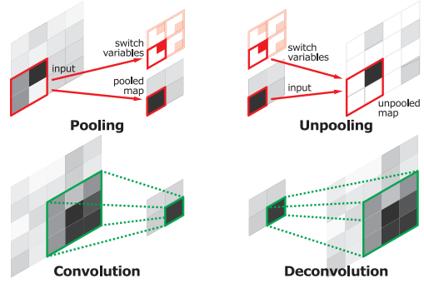
Appendix 2
Deconvolution
Perform the reverse operation of pooling and reconstruct the original size of activations [10]
[r1]. Noh, Hyeonwoo, Seunghoon Hong, and Bohyung Han. "Learning deconvolution network for semantic segmentation." In Proceedings of the IEEE international conference on computer vision, pp. 1520-1528. 2015.

Slide 54
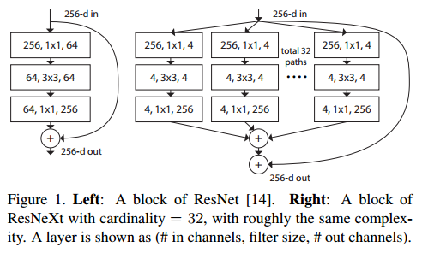
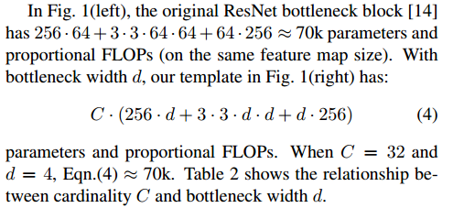
Appendix 3
ResNext module

